Slide 1


Check if String Can Be Split into Consecutive Descending Substrings
Welcome! This presentation explores an algorithm to determine if a string of digits can be split into consecutive descending substrings.
C. Kushwanthu
192211304

Slide 2


Problem Overview
1
The Challenge
2
Substrings & Values
3
Valid Split
Given a string of digits, our goal is to determine if it can be split into valid consecutive descending substrings.
Each substring must represent a numerical value that is greater than the next value by exactly 1.
A valid split consists of at least two substrings that meet the conditions.

Slide 3
Example Scenarios
Example 1: Valid Split
Example 2: Invalid Split
Input: "0090089"
Input: "001"
Valid Split: \["0090", "089"\]
Invalid Split: No descending consecutive values
Values: \[90, 89\]

Slide 4


Key Constraints
Digits Only
The input string can only contain digits (0-9).
Non-Empty Substrings
Each substring must contain at least one digit.
Descending Order
The numerical values represented by the substrings must be in descending order.
Difference of 1
Adjacent substrings must have values that differ by exactly 1.

Slide 5

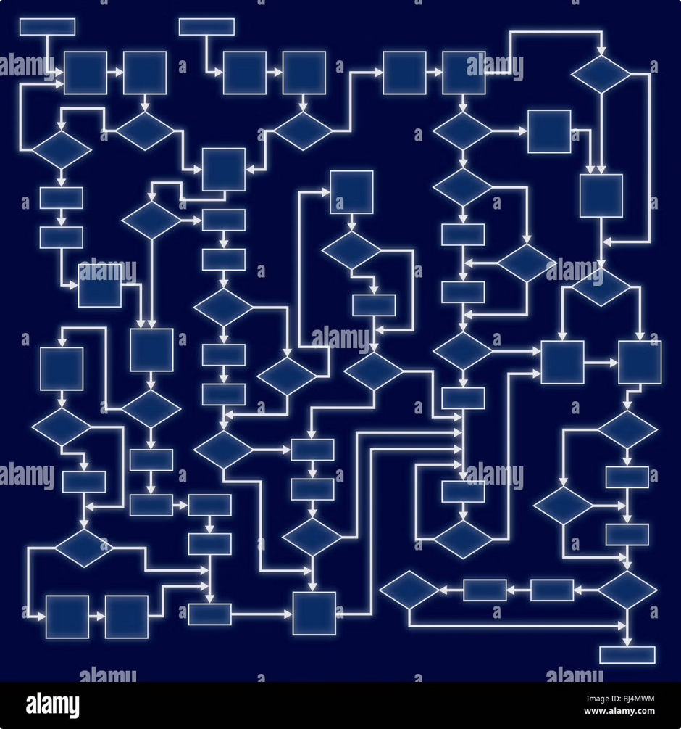
Approach to the Solution
1
Recursive Splitting
We'll recursively attempt to split the string into valid substrings.
2
Consecutive Checks
We'll start with larger substrings and check if their values are consecutive and descending.
3
Backtracking
If a substring is invalid, we'll backtrack and try a different split.

Slide 6





Algorithm Steps
Step 1: Substring Generation
Parse the string into all possible valid substrings.
Step 2: Condition Checks
Verify that each substring set meets the conditions.
Step 3: Valid Split
If a valid split is found, return "True"; otherwise, return "False."

Slide 7


Edge Cases
String with same digits
e.g., "0000"
Very short strings
e.g., "1" or "12"
Strings with no valid splits
e.g., "1234"

Slide 8

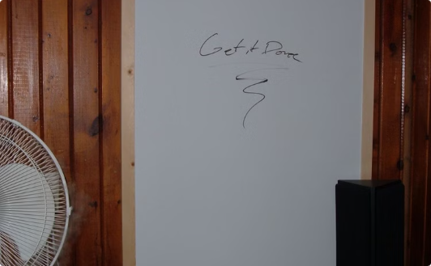
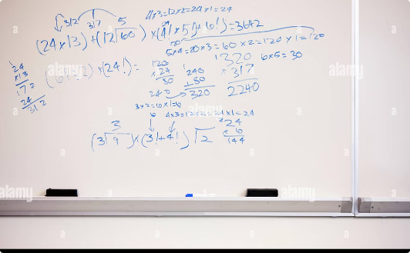
Example Walkthrough
Input: "0090089"
Step 1: Substring Generation
Step 2: Condition Checks
Let's break down how to check if this string has a valid split.
We'll check if the substrings meet the descending order and difference of 1 conditions.
We'll consider all possible substrings and their corresponding values.

Slide 9


Conclusion
1
Valid Split Conditions
2
Recursion and Backtracking
3
Key Takeaways
The string can be split into consecutive descending substrings with values differing by 1.
Understanding how to parse and analyze strings for specific patterns is essential in various algorithms.
This solution effectively utilizes recursion and backtracking to explore all possible splits.

Slide 10


Thank You
Thank you for your attention. Please feel free to ask questions or share your insights. Have a wonderful day!

